Slide 1
HLC Evidence Collection

Slide 2
Institutional Accreditation
Accreditation is not a separate burden imposed on Universities; accreditation is the process by which we are held accountable for our institutional effectiveness.
Notes:
Here is where I would talk about Accreditation is telling our story + showing our story.
While it seems like we are asking a lot now, the idea is that we manage this with an annual collection of data that will be more manageable in future years.
We may have 800 – 1000 documented pieces of evidence from departments and units all across the university that we need to collect, prioritize and use in the accreditation process, and starting now is better than waiting another 6 months, year, etc.

Slide 3
Criteria for Accreditation
Five Criteria (18 Core Components)
Mission
The institution’s mission is clear and articulated publicly; it guides the institution’s operations.
Integrity: Ethical and Responsible Conduct
The institution acts with integrity; its conduct is ethical and responsible.
Teaching and Learning: Quality, Resources, and Support
The institution provides quality education, wherever and however its offerings are delivered.
Teaching and Learning: Evaluation and Improvement
The institution demonstrates responsibility for the quality of its educational programs, learning environments, and support services, and it evaluates their effectiveness for student learning through processes designed to promote continuous improvement.
Institutional Effectiveness, Resources and Planning
The institution’s resources, structures, and processes are sufficient to fulfill its mission, improve the quality of its educational offerings, and respond to future challenges and opportunities.
Criteria for Accreditation (CRRT.B.10.010) | Policies (hlcommission.org)
Notes:
Five criteria covering the breadth of all university services, but the focus is on providing quality educational experiences to students.
Each criterion has 3-5 core components and multiple subcomponents that you will see on your evidence request tables.
There's a link in the lower right for you to read more about the criteria, core components and subcomponents.

Slide 4
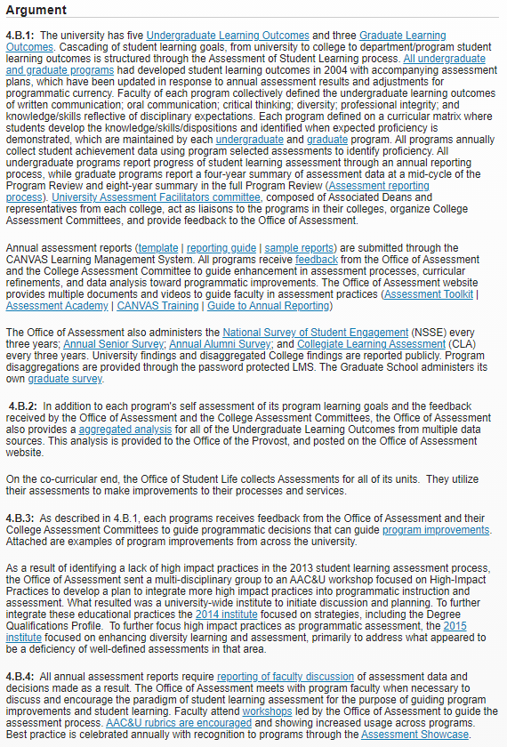
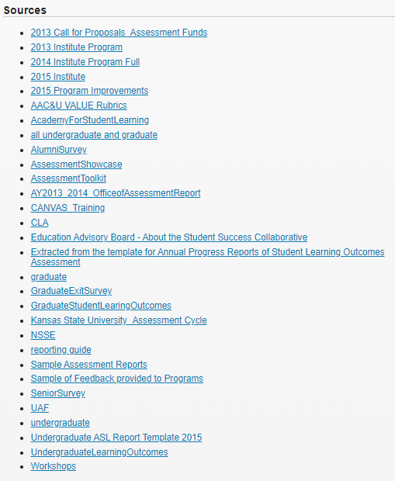
More Evidence-based Argument
Kansas State U
Assurance Argument
example
Criterion 4
Core Component 4B
Learning Assessment
Minimal text
Extensive sources
Notes:
When we talk about creating a story to share with the accreditors, that writing is a persuasive narrative filled with carefully selected evidence. The word count is limited, and the judgments are heavily influenced by the evidence.
In this example from Kansas State, you can see the wide variety and evidence needed to tell their story.
By the way, it's not unusual to have 30-50 pieces of evidence per core component. We're expecting to use somewhere between 800 and 1000 different evidence documents.

Slide 5
HLC Evidence Collection
HLC encourages institutions to provide thorough evidence and ensure that the sources it selects are relevant and persuasive.
Evidence should:
Explain any nuances specific to the institution;
Strengthen the institution’s overall record of compliance with HLC’s requirement; and
Affirm the institution’s overall academic quality and financial sustainability and integrity.
Notes:
But don't get stuck on the numbers too much. While evidence quantity is somewhat important (to demonstrate full compliance across all areas), it turns out that evidence quality is even more important. This is not a "throw everything and the kitchen sink" in there situation. Quality matters here.
HLC wants us to provide thorough, relevant and convincing evidence. We need to tailor our evidence choices to what makes OHIO a great and distinct institution. That's where the process that we've built comes into play. You provide the evidence, and the teams work to prioritize the highest quality evidence.

Slide 6
The Evidence Collection Cycle
Evidence Committees (ECs) Identify Possible Evidence
ECs Review Evidence & Perform Gap Analysis
ECs Provide Recommendations for the Coming Year
Units Respond with Evidence or Suggestions
Evidence Request Lists Combined
IEA Sends Requests for Evidence
Notes:
We are in the first year of our evidence collection cycle. We began at the top with the formation of the Evidence Collection Committees, who set out identifying where evidence could live. Then we combined the lists from the 6 committees and sent it to your offices, departments or units to collect. When you submit the evidence, it goes back to the committee for review and to identify any gaps. The gaps are important, because we still have time to start collecting evidence and filling those gaps before our report is due. The committees will make recommendations on what evidence needs to be collected through this process next year. In the end, we will ask for evidence each year, so that we don't have to have such a big ask anymore.

Slide 7
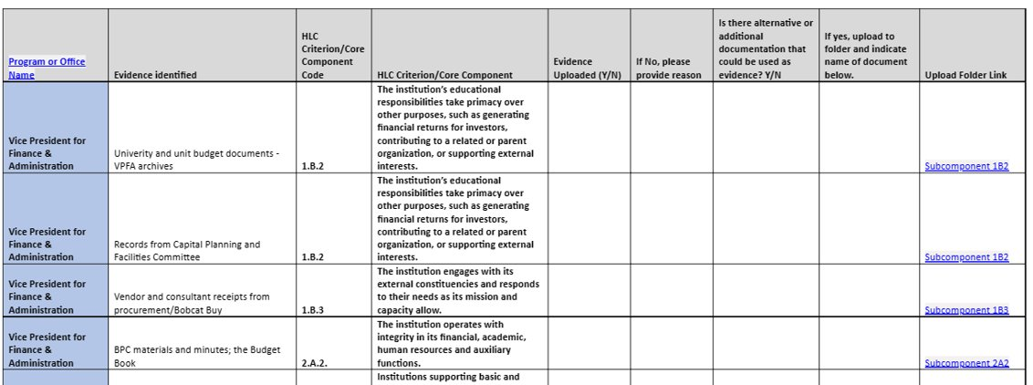
Evidence Request Table
Notes:
--understand how to read the subcomponent language—this is the question they need to answer with the evidence.
--Does the requested evidence answer that question? If yes or uncertain, please upload the evidence and you can send comments or notes to the committee
--go over the columns they can fill in
--If they have alternative evidence that might answer the question better, identify and upload and fill in the table.
--go over the Upload links—please put it in that folder and use the link to get to the proper folder. This helps us organize the information for the committees.

Slide 8
Evidence Request Table
Program or Office Name | Evidence identified | HLC Criterion/Core Component Code | HLC Criterion/Core Component | Evidence Uploaded (Y/N) | If No, please provide reason | Is there alternative or additional documentation that could be used as evidence? Y/N | If yes, upload to folder and indicate name of document below. | Upload Folder Link
Vice President for Finance & Administration | Univerity and unit budget documents - VPFA archives | 1.B.2 | The institution’s educational responsibilities take primacy over other purposes, such as generating financial returns for investors, contributing to a related or parent organization, or supporting external interests. | Y |  |  | University Budget Books for FY 20, 21, 22, 23; Budget planning guidance sent to VPs in Fall 2022 | Subcomponent 1B2
Vice President for Finance & Administration | Records from Capital Planning and Facilities Committee | 1.B.2 | The institution’s educational responsibilities take primacy over other purposes, such as generating financial returns for investors, contributing to a related or parent organization, or supporting external interests. | Y |  |  | Meeting minute and agendas from the Capital Planning and Facilities committee when this was discussed.(Relevant sections highlighted) | Subcomponent 1B2
Vice President for Finance & Administration | Vendor and consultant receipts from procurement/Bobcat Buy | 1.B.3 | The institution engages with its external constituencies and responds to their needs as its mission and capacity allow. | N | Receipts or other documentation from procurement or Bobcat Buy would not answer the question about how we engage our external constituencies. and the University responds with actions. | Y | Better evidence might be mtg agendas, conference schedules, mtg schedules, minutes where needs are discussed. Reach out to Event services or units hosting these events/mtgs. | Subcomponent 1B3
Notes:
--Let’s walk through example.
--The first two, do sound like they could answer the questions posed by the subcomponent, so you can upload evidence to the folder.
The third seems like a stretch. Remember that this is the first time the committee’s are doing this and they are also learning. So remember the point is to tell the institution and your unit’s story, so does this help answer that question, maybe not.
If not, here is how you can handle it and help educate the committee so they understand more about why this isn’t good evidence and where you think they might go next for better evidence.
--remember if it is a document where only part is relevant or a very long document please highlight where the actual evidence of answering the question is.

Slide 9
Using Core Components to Help Understand
If you aren't sure what the subcomponent is talking about, you can move one or two levels up for a broader view.
Use this link: HLC Criteria and Core Components to find more info
Criterion 3 | The institution provides quality education, wherever and however its offerings are delivered.
Core Component 3.A. | The rigor of the institution’s academic offerings is appropriate to higher education.
Sub-Component 3.A.1 | Courses and programs are current and require levels of student performance appropriate to the credential awarded.
This Photo by Unknown author is licensed under CC BY-SA-NC.
Notes:
If you are feeling confused about the language of a subcomponent that you have been assigned (3.D.4 or 1.C.3 for example), you can always move a little higher to get a broader picture of what HLC is talking about. In slide #9, subcomponent 3.A.1 is asking the unit to provide evidence about whether courses and programs are appropriate for the credential. What does "appropriate" mean here? Well, you might look a little broader by going to the component 3.A. and reading that the focus is on the rigor of the academic programs, and some political or cultural opinion of "appropriate courses or programs. And if you look higher at the criterion level, you can see the emphasis is on the quality of higher education offerings. So from there, you know you're trying to provide evidence of high-quality programs and courses.

Slide 10
Evaluating the Evidence
Quality over Quantity
BUT, documentation across the institution—breadth of evidence
Focus on 2019 forward
Unless the evidence precedes 2019
For Example, the approval of the Mission
Look at the HLC Evidence guidelines
Prioritize Clear Evidence

Slide 11
HLC Evidence Guidelines
HLC encourages institutions to provide thorough evidence and ensure that the sources it selects are relevant and persuasive.
Evidence should:
Explain any nuances specific to the institution;
Strengthen the institution’s overall record of compliance with HLC’s requirement; and
Affirm the institution’s overall academic quality and financial sustainability and integrity.
Notes:
As we saw before, HLC has guidelines and guidance to help us present the best evidence. We need to have breadth in our scope, but be really tailored in how we describe our adherence to the criteria and components.
Remember, that we need to show quality evidence in the three key areas of: academic quality, financial sustainability and integrity.

Slide 12
A Focus on Clear Evidence
Three types of evidence:
Clear evidence
Corroborating evidence
Circumstantial evidence

Slide 13
A Focus on Clear Evidence
Types of Evidence:
Clear evidence
precise, explicit and tends to directly establish the point it is presented to support. Institutions should provide clear evidence of their compliance with each Core Component.
Example:
Clear evidence that a president was duly appointed by an institution’s board would be a board resolution or meeting minutes showing a motion and vote to hire the president.
Notes:
Clear evidence is the highest, most direct form of evidence.

Slide 14
What is Compelling Evidence?
Types of Evidence:
Corroborating evidence
supplementary to evidence already given and tends to strengthen or confirm it. This type of evidence can be useful in illustrating points made in the institution’s narrative, but it may not be persuasive to peer reviewers on its own.
Example: Corroborating evidence that a president was duly appointed by an institution’s board would be a copy of the offer letter addressed to the president.

Slide 15
What is Compelling Evidence?
Types of Evidence:
Circumstantial evidence
establishes a condition of surrounding circumstances, from which the principal fact may be inferred. This type of evidence is never sufficient on its own.
Example: Circumstantial evidence that a president was duly appointed by an institution’s board would be a copy of a letter from the president to the chair of the board, accepting the presidential appointment.

Slide 16
What is Compelling Evidence?
Three types of evidence:
Clear evidence
Corroborating evidence
Circumstantial evidence
Notes:
When we have clear evidence, we want to use it. It's direct and the most convincing. But that won't always be an option, and the evidence committees will need to have some corroborating and/or circumstantial evidence in case they can't identify clear evidence.

Slide 17
The Evidence Collection Cycle
Evidence Committees (ECs) Identify Possible Evidence
ECs Review Evidence & Perform Gap Analysis
ECs Provide Recommendations for the Coming Year
Units Respond with Evidence or Suggestions
Evidence Request Lists Combined
IEA Sends Requests for Evidence
Notes:
I know that we're asking a lot and you may feel overwhelmed. But remember that this is the first time we are making the ask. As the committees review the evidence, they will identify gaps and overlaps (places where there's lots of evidence). They will be able to refine the requests for future years.
Next year, we will only ask for updates to the evidence we're collecting this year.

